Slide 1

UNIVERSITI TEKNOLOGI MALAYSIA
FLIGHT DELAY PREDICTION MODEL USING MACHINE LEARNING
Name: Siti Nur Elisya Aqmar Binti Mohamad Kamal
Matric No: MCS241056
Faculty of Computing, UTM
Date: June 2025

Slide 2
INTRODUCTION
Accurate delay prediction = improves airline efficiency
Flight Delay Affect
Passengers
Cost
Machine Learning (ML) is ideal for handling complex aviation data.
Operations

Slide 3
PROBLEM BACKGROUND
PROBLEM STATEMENT
Weather
Current systems are reactive, not predictive.
Need for data-driven solutions using ML.
Goal: Forecast delays proactively for better decision-making.
Delays Caused
technical issue
congestion
Traditional methods lack of accuracy and adaptability

Slide 4
RESEARCH GOAL & OBJECTIVE
To build and compare machine learning models to predict flight delays
Collect and preprocess flight/weather data
Apply and compare Random Forest, XGBoost, ATT-BI-LSTM.
Identify best model via evaluation metrics.

Slide 5
SCOPE OF RESEARCH
Focus on historical structured data (Nov 2019–Dec 2020).
Excludes real-time or unscheduled flight data.
Supervised ML techniques only.

Slide 6
REPORT STRUCTURE
Chapter 1: Introduction
Chapter 2: Literature Review
Chapter 3: Research Methodology
Chapter 4: Results & Discussion
Chapter 5: Conclusion & Recommendation

Slide 7
LITERATURE REVIEW
Author | Research Title | Year | Research Focus | Methods
Yazdi, M., et al. | Flight Delay Prediction Based on Deep Learning and Levenberg-Marquardt Algorithm | 2020 | U.S. flight data (5 years of historical flight schedules) from theBureau of Transportation Statistics. Includes 27 attributes (e.g., flight dates, delays, weather, airports, taxi times). | Deep Learning and Levenberg-Marquardt Algorithm
Zhe Zheng, Wenbin Wei, Minghua Hu | A Comparative Analysis of Delay Propagation on Departure and Arrival Flights for a Chinese Case Study | 2021 | Flight-level records (2016) from the Air Traffic Management Bureau of CAAC, covering 1,469,909 flights between top 30 Chinese airports. METAR weather reports(temperature, wind speed, visibility, convective weather) for these airports. | Econometric models: Ordinary Least Squares (OLS) regression with clustered
Zhan Shu | Analysis of Flight Delay and Cancellation Prediction Based on Machine Learning Model | 2021 | Kaggle dataset(2018 U.S. domestic flights): Includes 27 attributes (e.g., flight dates, delays, weather, airline IDs, airports, taxi times). Focus on 2018 data (subset of 2009–2018 dataset). | Random Forest Classifier, Logistic Regression, Naive Bayes. Regression (delay prediction): Random Forest Regressor, Linear Regression. Evaluated via ROC-AUC and MSE.

Slide 8
LITERATURE REVIEW
Author | Research Title | Year | Research Focus | Methods
Gui, G., et al. (School of Electronic and Information Engineering, Beihang University, China) | Flight Delay Prediction Based on Aviation Big Data and Machine Learning | 2019 | ADS-B messages integrated with weather, flight schedules, and airport information. Timeframe: December 2018–May 2019. Size: 5,761 flight records (3,368 no-delay, 2,393 delayed). Coversall routes/airports within the ADS-B platform. | LSTM-based architectures: Standard LSTM, LSTM with fully connected layers, LSTM with dropout layers. Random Forest classifier.
Mamdouh, M., Ezzat, M., Hefny, H., et al. (Department of Computer Science, Helwan University, Egypt) | Improving Flight Delays Prediction by Developing Attention-Based Bidirectional LSTM Network | 2024 | US flight data (2019–2020) integrated with weather features(wind, temperature, precipitation. | Primary model:Attention-based Bidirectional LSTM (ATT-BI-LSTM). Comparative models: GRU, RNN, LSTM, ATT-LSTM, Deep LSTM, and hybrid models (PSO+LSTM, ACO+LSTM, etc.).
Ahmad Adib Baihaqi Shukri, Syarifah Adilah Mohamed Yusoff, Saiful Nizam Warris, Mohd Saifulnizam Abu Bakar, Rozita Kadar | Machine Learning Approach of Predicting Airline Flight Delay Using Naive Bayes Algorithm | 2024 | 2020 flight dataset with 28,821 samples and 23 attributes (e.g., departure/arrival delays, weather, flight schedules). | Naive Bayes algorithm for classification.

Slide 9
RESEARCH METHODOLOGY
Start
Topic Selection
Phase 1: Planning and Initial Study
This research framework includes the following steps:
1.Problem Definition and Literature Review
2. Data Collection: Gather flight and weather data specific to Malaysia.
3. Data Pre-processing: Clean, balance, and prepare data for modelling
4. Model Development: Clean, balance, and prepare data for modelling
5. Model Evaluation: Compare performance and validate models.
Literature Review
Machine Learning
Prediction and Modeling
Challenges and Future Scope
Phase 2: Data Preparation
Data Acquisition
No
Data Cleaning
Yes
Phase 3: Data Derivation
Data Derivations
Setup Machine Learning Model
Phase 4: Model Development
Model Development
Phase 5: Model Evaluation
Model Evaluate
End

Slide 10
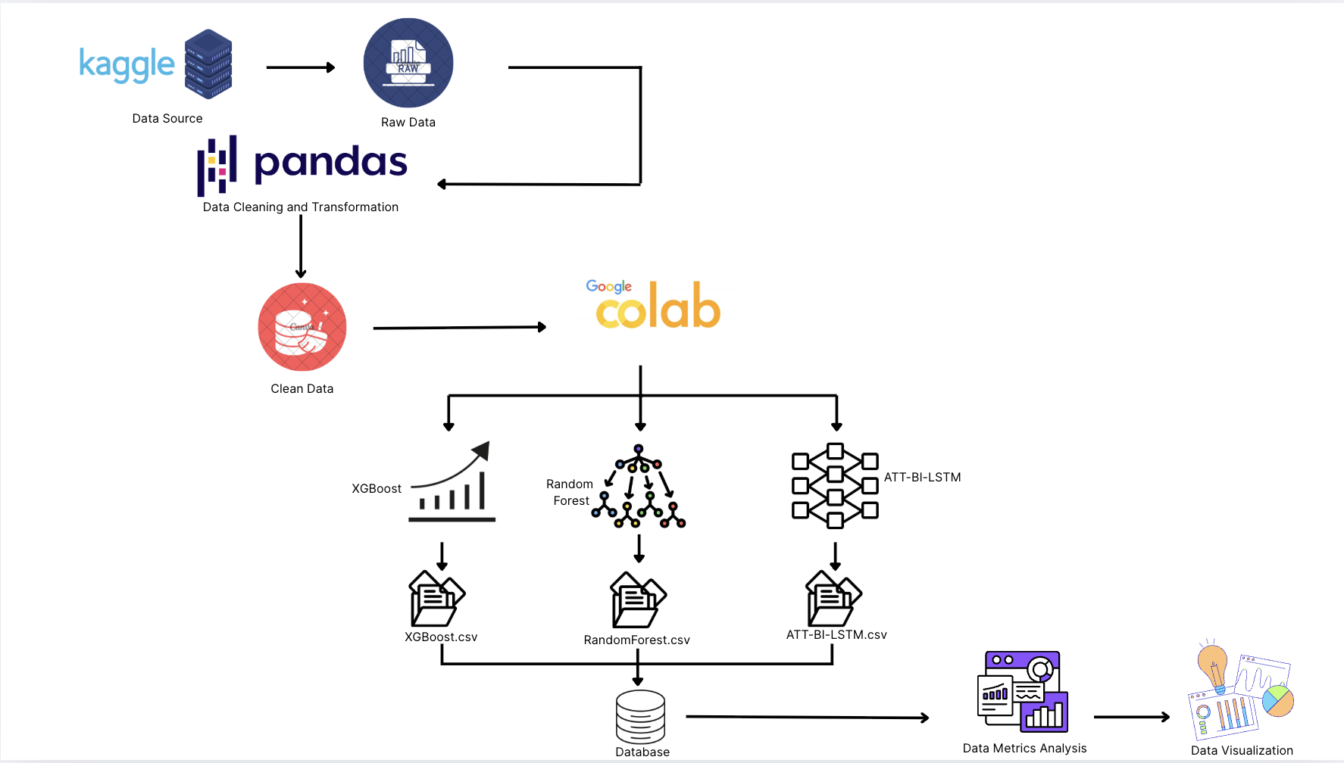
DATA PREPROCESSING

Slide 11
OVERVIEW OF DATASET
Source: M1_final.csv from Kaggle
Total records: 28821, with 23 features
Key attributes: departure time, airline, route, weather, delay label
Delay label distribution: imbalanced dataset (e.g., 70% on-time, 30% delayed)

Slide 12
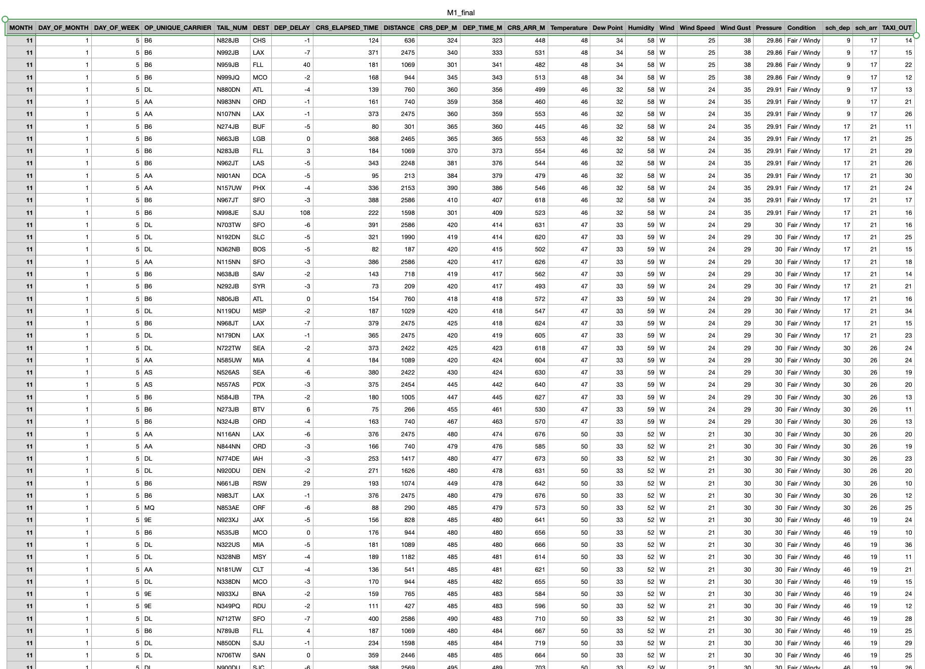
DATA EXPLORATION
Peak delays observed during morning and late evening
Higher delays on specific weekdays
Certain airlines/routes show consistently higher delay rates
Weather variables show correlation with delay likelihood

Slide 13
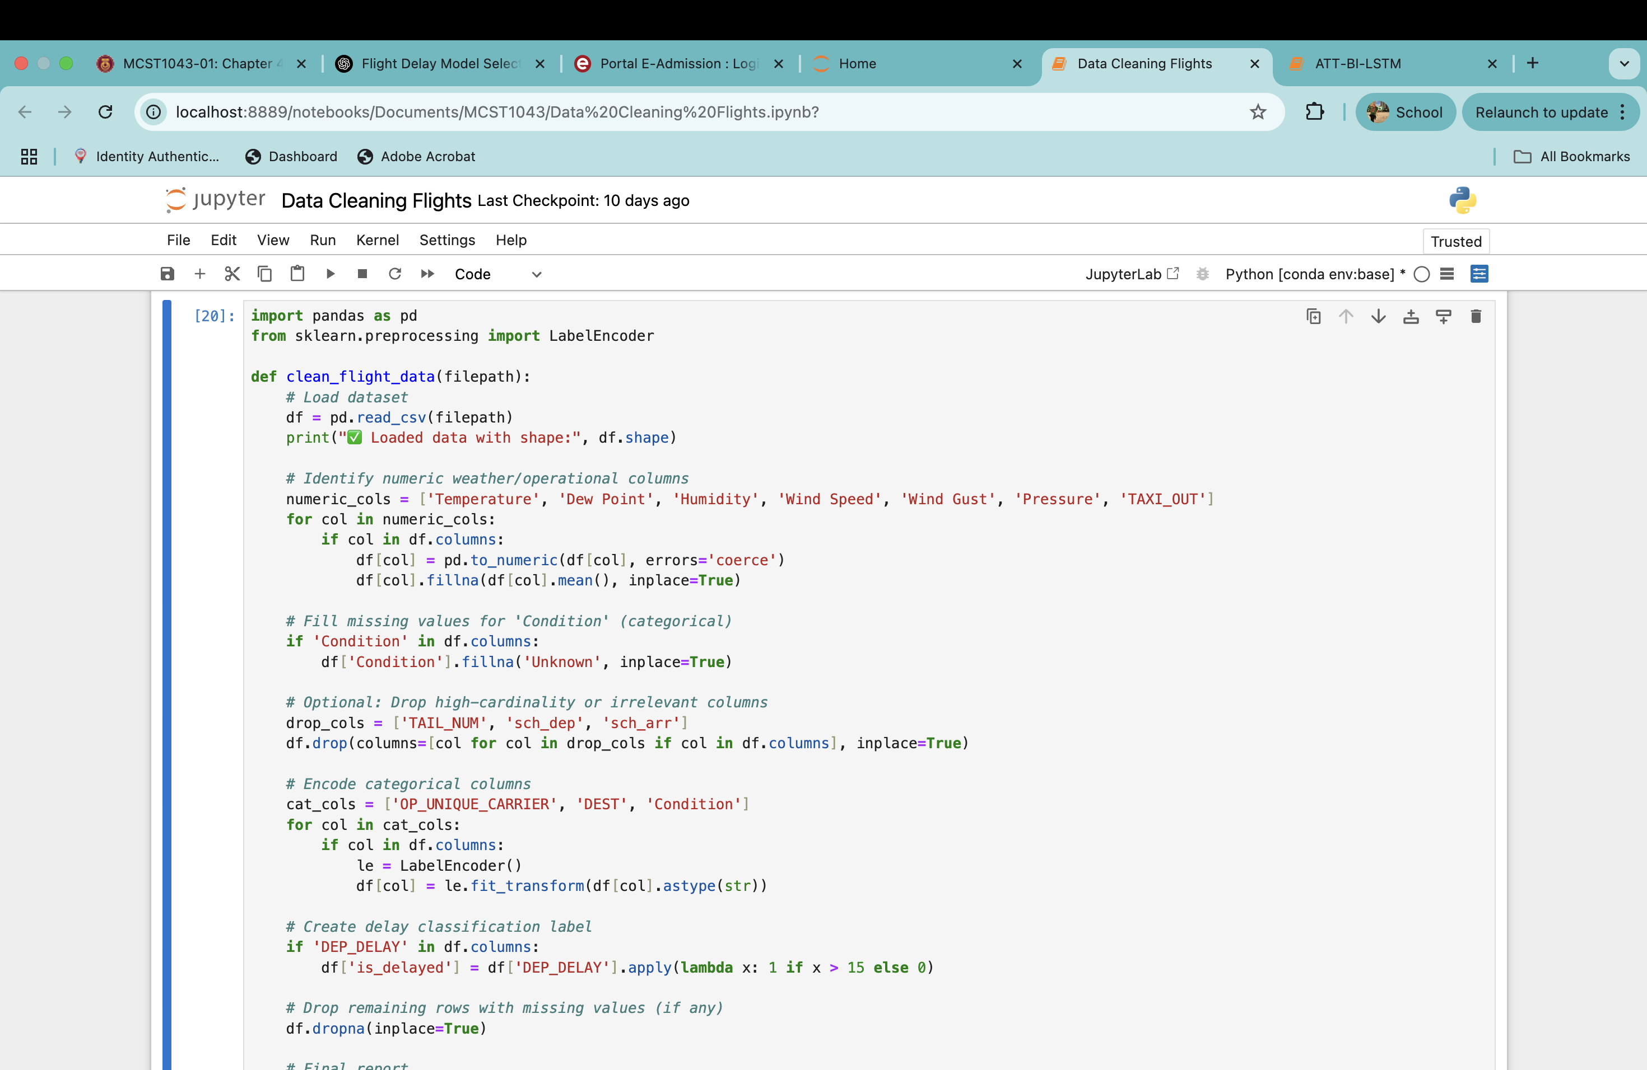
DATA PREPROCESSING INSIGHTS
pandas: Used for loading, manipulating, and cleaning structured data (dataframes).
LabelEncoder: Converts categorical string values into numerical values for machine learning.
Defines a reusable function called clean_flight_data that takes the path to a CSV file as input.
Loads the CSV into a DataFrame.
Prints the number of rows and columns (shape) to confirm successful loading.
Lists columns expected to contain numerical data.
Loops through these columns:
Converts values to numbers (coerce turns invalid values into NaNs).
Replaces any missing (NaN) values with the column’s mean value.
Fills missing values in the 'Condition' column with the label 'Unknown'.
Defines a list of columns to remove:
TAIL_NUM: Aircraft tail number – often unique and not useful for prediction.
sch_dep, sch_arr: Scheduled departure/arrival time – may be replaced by encoded versions elsewhere.
Drops them if present.
Specifies columns with categorical string values to convert into numbers.
For each listed column:
Converts the data to string (in case it's not).
Uses LabelEncoder to convert each category into a unique integer.

Slide 14
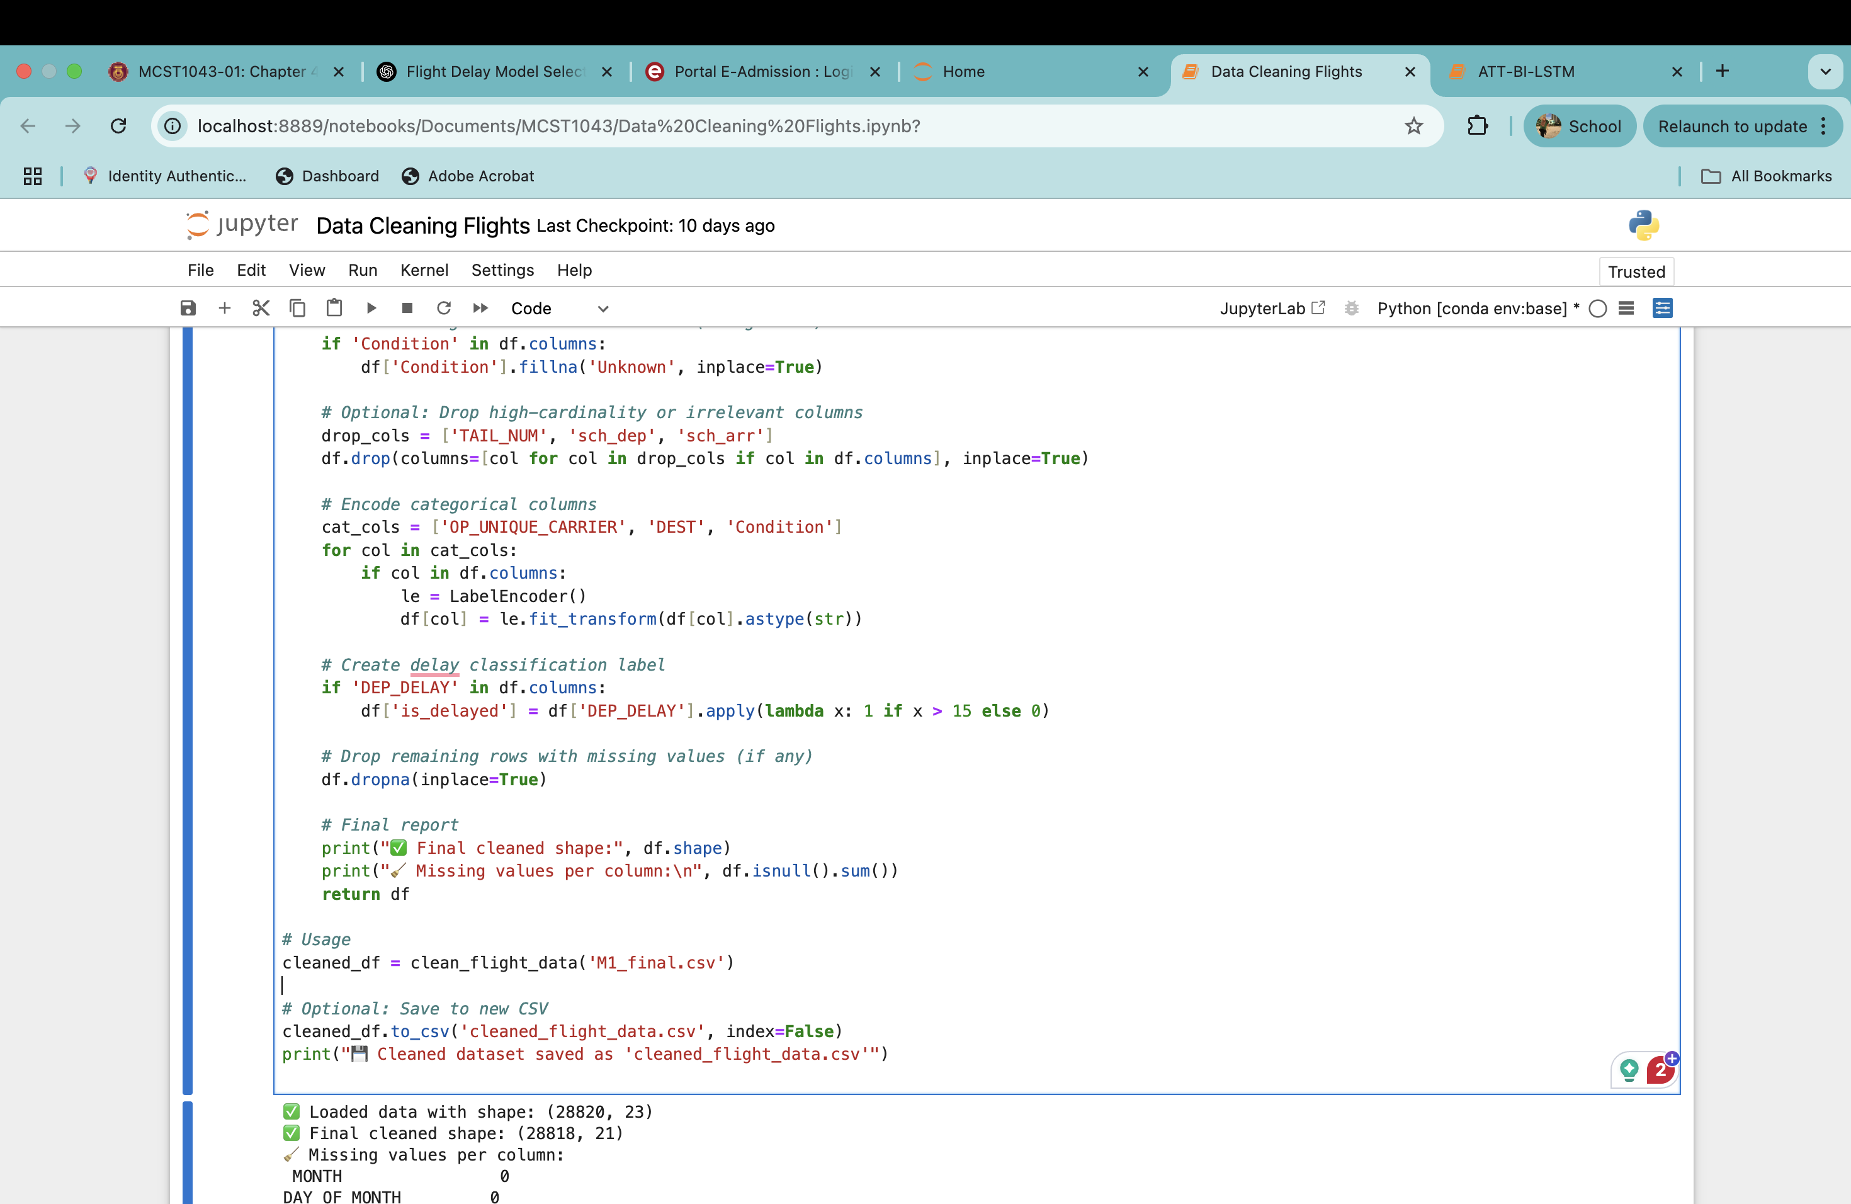
Adds a new column is_delayed:
If the departure delay is more than 15 minutes, it marks the flight as delayed (1), otherwise not delayed (0).
This column becomes the target label for classification.
Removes any rows that still contain missing values.
Displays the final dataset shape.
Shows the count of any remaining missing values by column (should be zero).
Calls the function and applies it to the 'M1_final.csv' file.
Saves the cleaned DataFrame to a new CSV file.
Confirms the file has been saved

Slide 15
MODEL-SPECIFIC OBSERVATION
Machine Learning | Observation
ATT-BI-LSTM | Strong recall and sequence learning
Random Forest | Good accuracy, interpretable, less effective on time data
XGBoost | Balanced performance, robust to noise, great AUC

Slide 16
COMPARATIVE PERFORMANCE TABLE
Metric | Random Forest | XGBoost | ATT-BI-LSTM
Accuracy | 0.88 | 1.00 | 0.90
Precision (Class 1) | 0.89 | 1.00 | 0.98
Recall (Class 1) | 0.15 | 1.00 | 0.26
F1-Score (Class 1) | 0.26 | 1.00 | 0.41
Precision (Class 0) | 0.88 | 1.00 | 0.89
Recall (Class 0) | 1.00 | 1.00 | 1.00
F1-Score (Class 0) | 0.93 | 1.00 | 0.94
Macro Avg F1-Score | 0.60 | 1.00 | 0.68
Weighted Avg F1 | 0.84 | 1.00 | 0.87
Support (Total Samples) | 5764 | 5764 | 5764

Slide 17
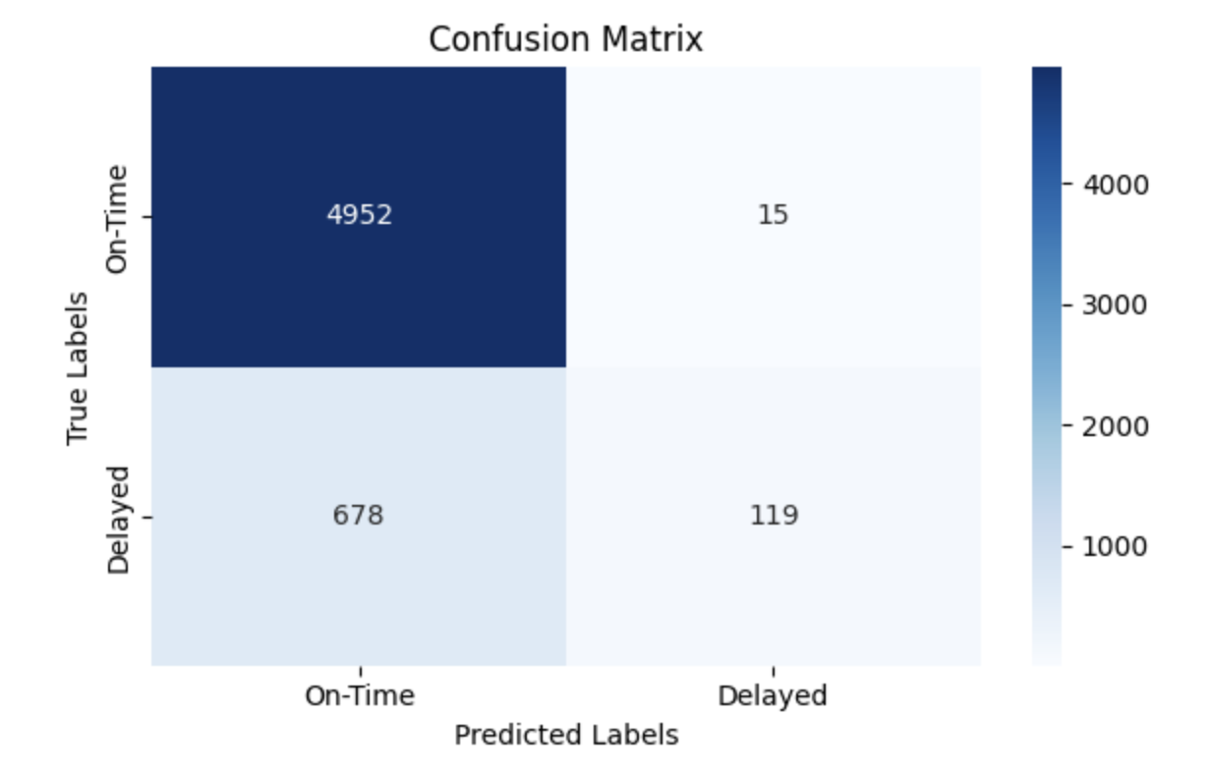
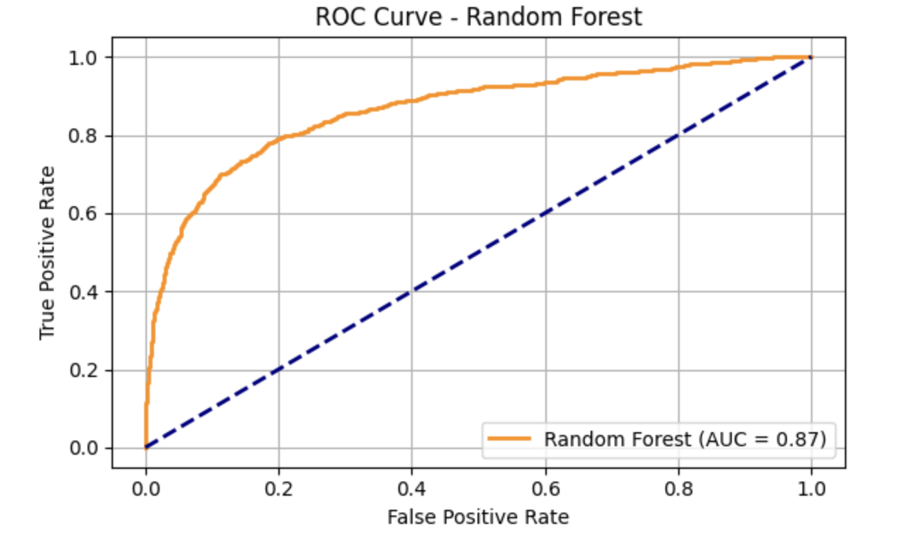
CONFUSION MATRIX & ROC
RANDOM FOREST

Slide 18
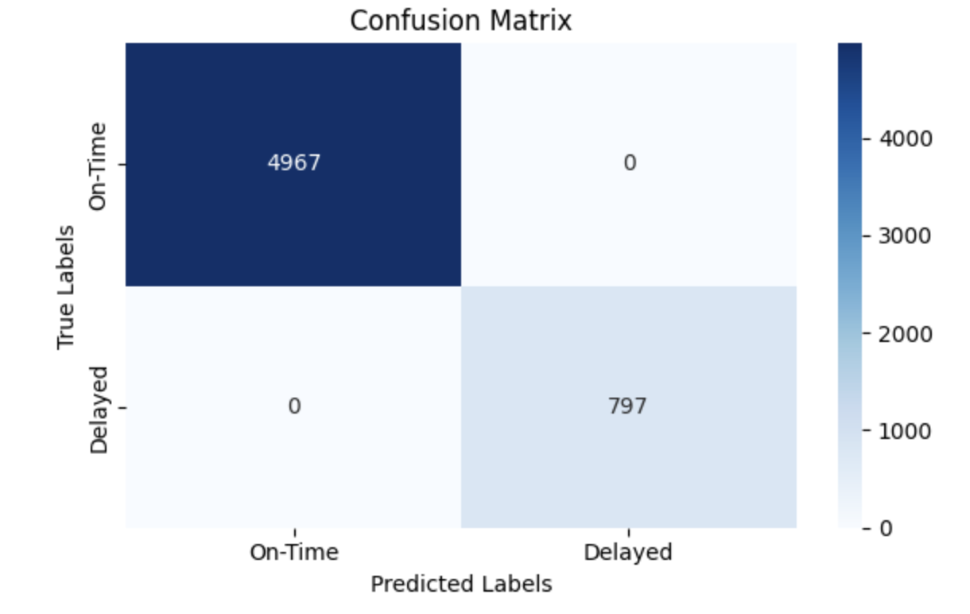
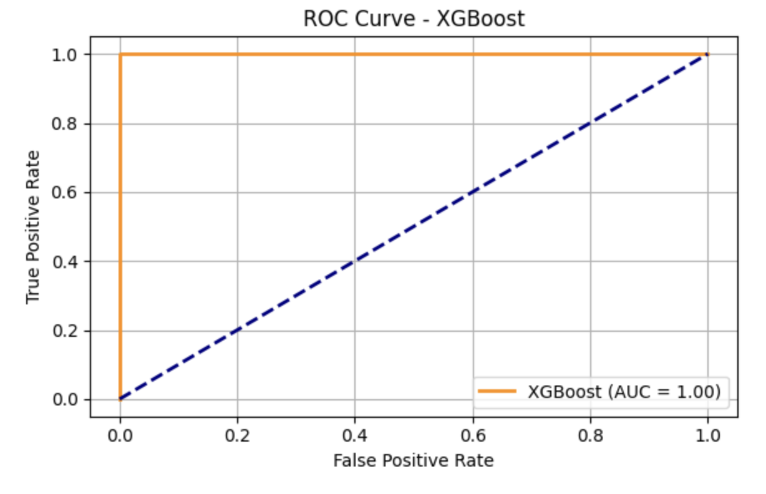
XGBOOST

Slide 19
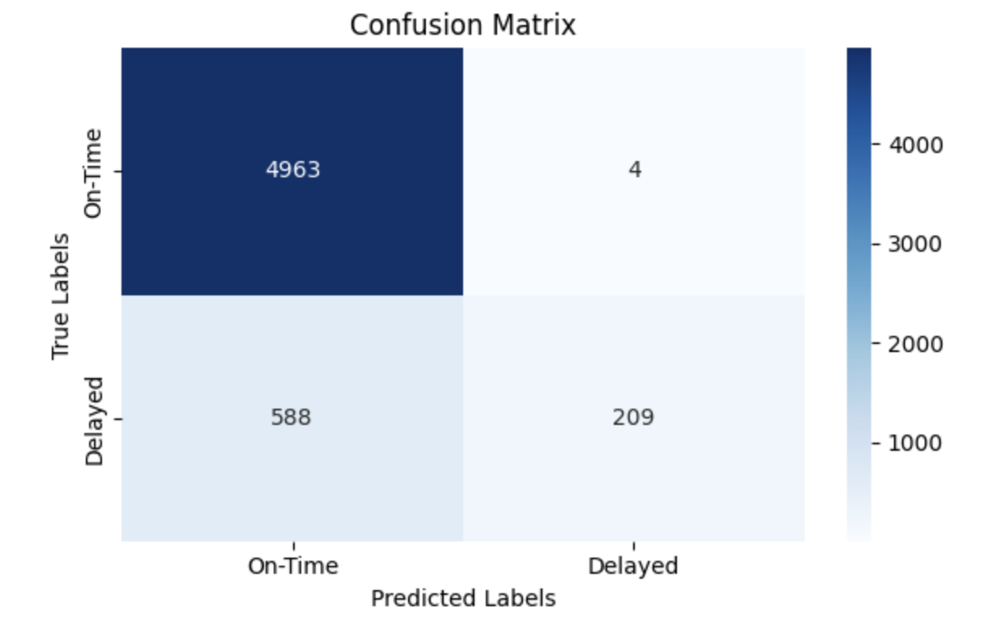
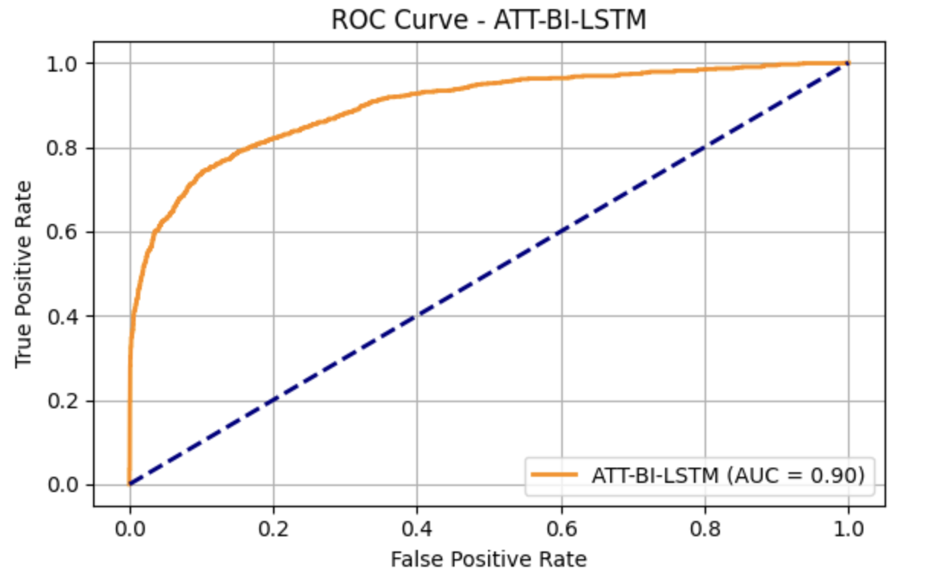
ATT-BI-LSTM

Slide 20
KEY TAKEAWAYS
Machine Learning | Results
ATT-BI-LSTM | best for detecting delays in sequence-based data
Random Forest | suitable when model transparency is important
XGBoost | offers strong overall balance of performance and efficiency

Slide 21
CONCLUSION
ML improves delay prediction, especially XGBoost and ATT-BI-LSTM.
Data preprocessing is critical
Time and weather are key influencing factors.
ATT-BI-LSTM better at identifying delayed flights

Slide 22
RECOMMENDATIONS & FUTURE WORK
Add real-time data and multiple airport inputs.
Try transformer models like BERT, TFT.
Use Explainable AI (XAI) to improve trust and understanding
Integrate live system for dynamic predictions

Slide 23


THANK YOU
utmofficial
univteknologimalaysia
utm.my

Slide 24
Video Presentation Link:
https://youtu.be/KhbUoRJMH0Y

